Slide 1


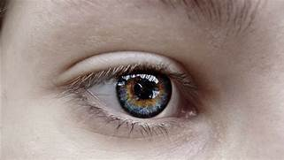
SNS COLLEGE OF ENGINEERING Kurumbapalayam (Po), Coimbatore – 641 107 AN AUTONOMOUS INSTITUTION Accredited by NBA – AICTE and Accredited by NAAC – UGC with ‘A’ Grade Approved by AICTE, New Delhi & Affiliated to Anna University, Chennai
Colour detection for colour blind people
Batch - 3
TEAM MEMBERS:
Krishna Kumar S
Santhosh M
Gowtham
Venkat

Slide 2
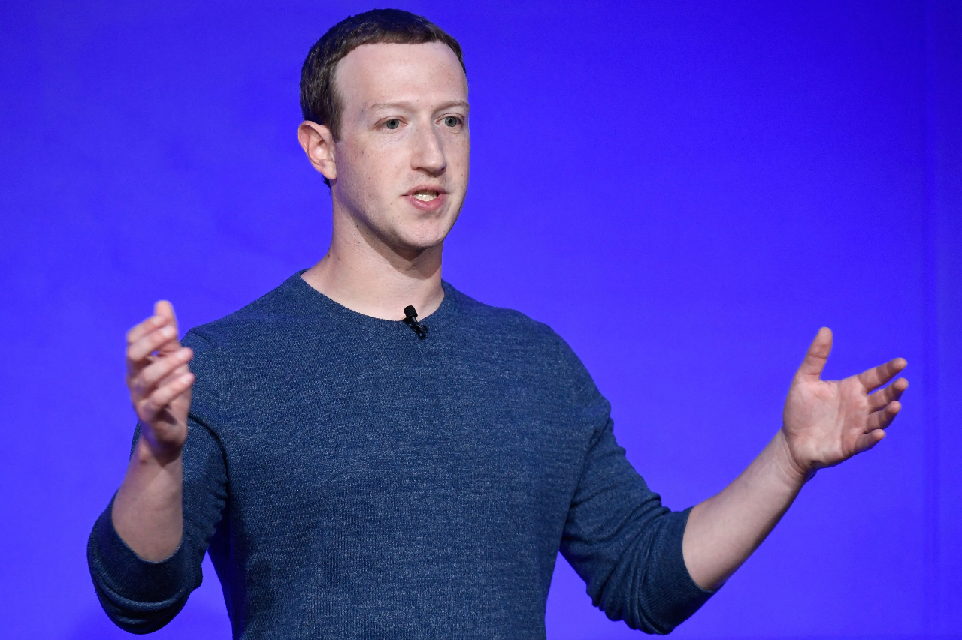


Slide 3
Empathy
Seeing Is Believing
Going into this experiment, all I knew was that red and green look similar to a colour blind person, and previously I hadn’t thought much more about it. But what does that really mean?
Does green look like red ? Are all trees red to him/her ?, If that’s the case, how can he ,tell when the trees change color in the fall? Or does red look like green? Do all warning labels look like eco-friendly labels?
What are all the struggles mark face ?

Slide 4
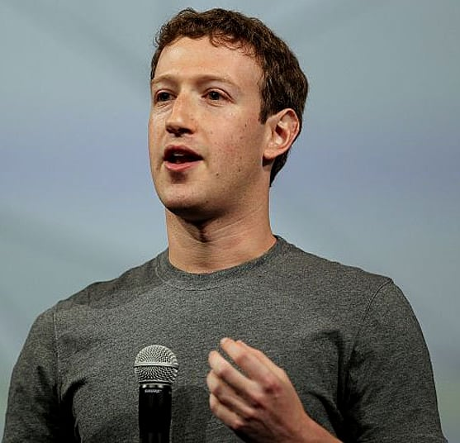
Thinks
What if my friends make fun of me ?
Is this the right place , where I wanted to be ??
Will I get a solution for my problem ??
Says
Does
Staying at home
Giving excuses
Why am I colour blind ??
I can't identify colours
Sorry , I can not differentiate traffic signs and recycle boards.
I'm fed up of my problem
The enchroma glasses are too much expensive
Regular eye treatment
Buying expensive glasses
Watching everything with keen attention.

Slide 5





Feels
Frustrated
Annoyed
Stressed
Insecure
Alone

Slide 6
Define
What difficulties are the users facing?
What are the patterns of their everyday behavior?
What needs to be changed and what should remain the same ?

Slide 7
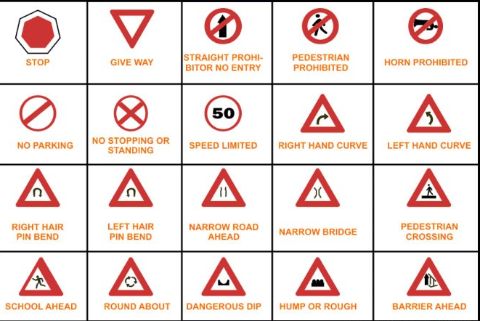

Problems
Define cont...
Traffic signs and signals

Slide 8
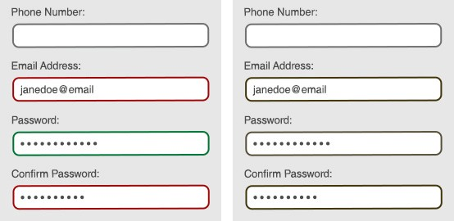
Define cont...
Problems
Email login:-

Slide 9
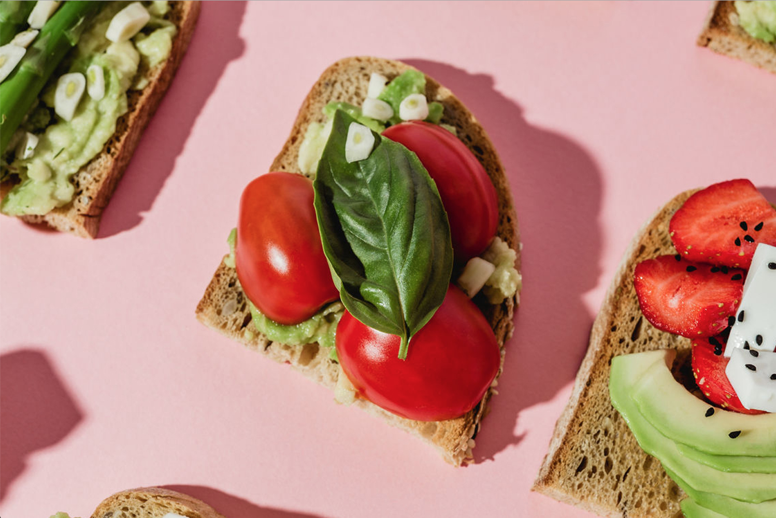
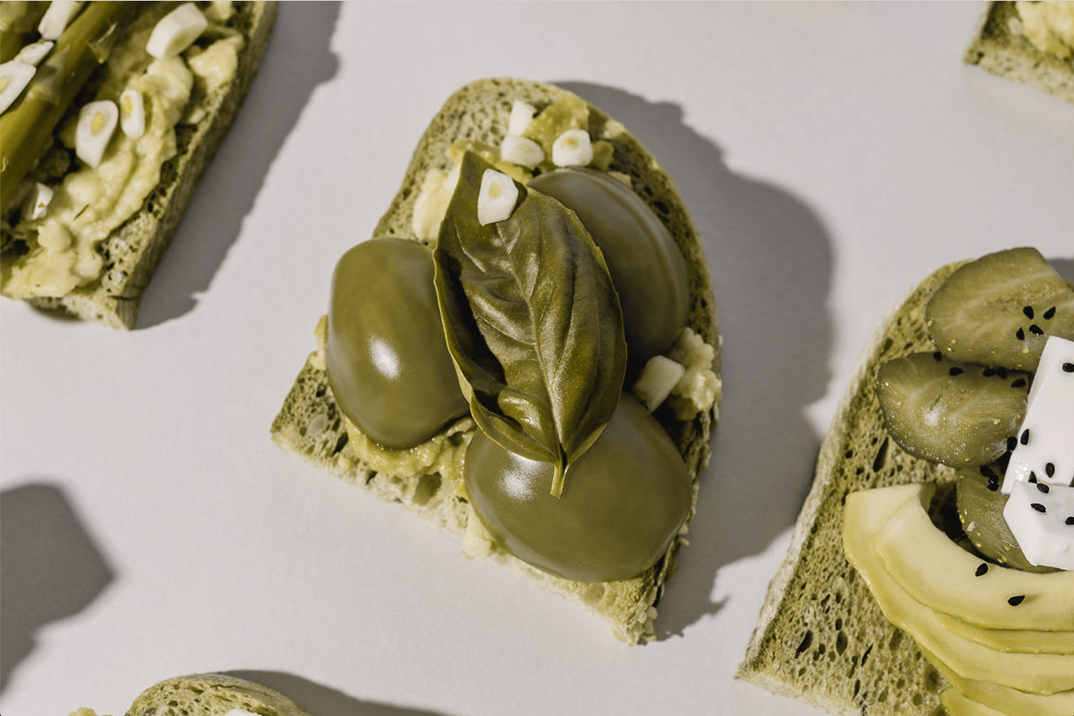

Slide 10
Define cont...
Analyze :-
Who are we empathizing with?
Here the key and main users are the people Who are color blind.
Users who have red or green deficient eye sight.
Color blinded people who cannot afford expensive specs and contact lens.

Slide 11
What needs to be changed ?
Analyze contin....
To solve , Deutan color blindness (This is “green-deficient” color blindnes).
To solve Protan color blindness (This causes “red-deficient” color blindness).
The colours should be changed , that are easy for them to differentiate
But, is it possible to change each colour everywhere ?

Slide 12
Synthesis
Color blindness affects the livelihood of the user.
People suffering from color blindness are unable to differentiate red and green, which makes their regular life difficult , causing them to get frustrated and feel annoyed .
Other sollutions for this problem like special enchroma glasses are too expensive , so that not every person are able to buy it.

Slide 13

Problem statement
"We need to find a solution that is cheap, effective and help them differentiate colors."

Slide 14
Ideate
Wearing expensive
Enchroma
glasses
Regular checkup
and risky surgeries
Changing traffic sign colours
Using contact lens

Slide 15
Our solution
. Create a python program, that detects red colour.
. This program differentiates red and other colours , by indicating it as white and other colors as black.
. It can be used in mobile apps , car cams , browsers, etc...

Slide 16
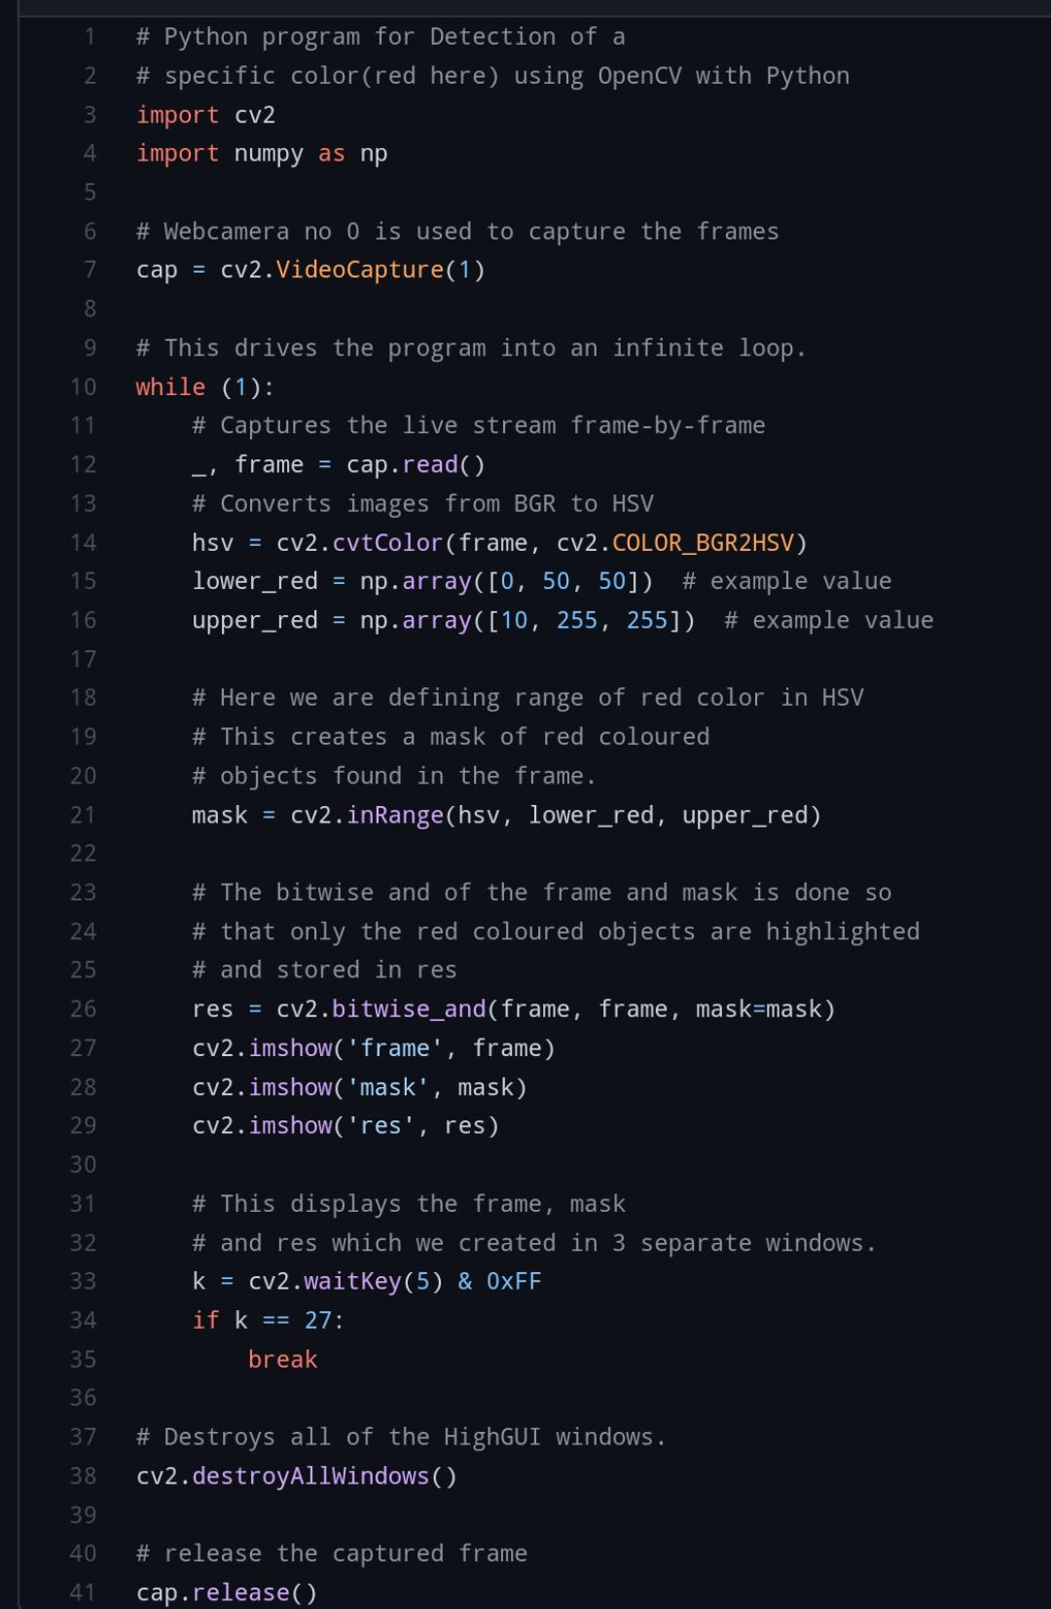
Prototype
Colour detection

Slide 17
THANK YOU Any questions ??

